Slide 1
Applying Machine Learning for Intrusion Detection in Network Security
Using Random Forest Algorithm
By
Rincy Mariam Thomas
Directory ID - rmt21
UID - 120124044
Course and Section - ENPM693 CY01
Notes:
Today, I'll be presenting my project on applying machine learning for intrusion detection in network security, specifically using the Random Forest algorithm."

Slide 2
Introduction
Intrusion detection plays a crucial role in maintaining network security by identifying malicious activities.
The objective of this project is to apply machine learning techniques, specifically the Random Forest algorithm, for intrusion detection.
By leveraging the NSL-KDD dataset, the aim is to develop a model capable of accurately classifying network traffic as normal or intrusive.
Notes:
"Intrusion detection is crucial for maintaining network security as it helps identify and mitigate malicious activities."
"The main goal of my project is to leverage machine learning techniques, particularly Random Forest, to accurately classify network traffic as either normal or intrusive."
"To achieve this, I've utilized the NSL-KDD dataset, aiming to develop a robust model for intrusion detection."

Slide 3
Project Overview
Utilize the NSL-KDD dataset for consistency in comparisons across projects.
Dataset Source: NSL-KDD Dataset
Consistent Feature Selection:
Features:
@attribute 'src_bytes' real - Amount of data sent from the source to the destination.
@attribute 'dst_bytes' real - Amount of data sent from the destination back to the source.
@attribute 'protocol' {'tcp','udp', 'icmp'} - Communication protocol used.
Target Variable:
@attribute 'class' {'normal', 'anomaly'} - Identifies the class of network traffic as either 'normal' or 'anomaly', facilitating intrusion detection and security analysis.
Purpose:
Ensure uniformity in input data among all projects for meaningful comparisons.
Facilitate the evaluation of machine learning algorithms' performance.
Evaluate the performance of Random Forest and compare results with other algorithms like Isolation Forest, KNN, and K-Means.
Notes:
"I chose the NSL-KDD dataset for consistency in comparisons across projects and to ensure uniformity in input data."
"The dataset includes features such as 'src_bytes,' 'dst_bytes,' and 'protocol,' with the target variable 'class' identifying network traffic as 'normal' or 'anomaly.'"
"This ensures meaningful comparisons and facilitates the evaluation of various machine learning algorithms' performance."

Slide 4
What is Random Forest and Why Use It?
Random Forest is an ensemble learning method that constructs a multitude of decision trees during training and outputs the mode of the classes as the prediction.
By employing an ensemble learning approach, this project effectively reduces overfitting and enhances generalization by aggregating multiple decision trees' predictions.
Reasons for using Random Forest:
Robustness: Handles high-dimensional data with categorical and numerical features effectively.
Flexibility: Suitable for both classification and regression tasks.
Highlighting the versatility and performance of Random Forest sets the stage for its application in intrusion detection.
Notes:
"Random Forest is an ensemble learning method that constructs multiple decision trees during training and outputs the mode of the classes as the prediction."
Advantages:
"One of the key advantages of Random Forest is its robustness in handling high-dimensional data with categorical and numerical features."
Application in Intrusion Detection:
"Random Forest's flexibility makes it suitable for both classification and regression tasks, making it an ideal choice for our intrusion detection project."

Slide 5
What is PCA and Its Purpose?
Principal Component Analysis (PCA) is a dimensionality reduction technique used to simplify complex datasets while preserving essential information.
Purpose of PCA:
Dimensionality Reduction: Reduces the number of features while retaining as much variance as possible.
Visualization: Projects high-dimensional data into a lower-dimensional space for easier visualization and interpretation.
Noise Reduction: Eliminates redundant or irrelevant features, enhancing model efficiency and performance.
Notes:
"Principal Component Analysis (PCA) is a dimensionality reduction technique used to simplify complex datasets while preserving essential information."
Key Uses:
"PCA aids in dimensionality reduction, visualization of high-dimensional data, and noise reduction, enhancing model efficiency and performance."

Slide 6
Methodology - Without PCA
Preprocess the dataset by encoding categorical variables and scaling numerical features.
Train a Random Forest classifier using GridSearchCV for hyperparameter tuning.
Evaluate model performance using accuracy, confusion matrix, and classification report.
Notes:
Dataset Preprocessing:
"We begin by encoding categorical variables and scaling numerical features to prepare the dataset for training."
Model Training:
"Next, we train a Random Forest classifier using GridSearchCV for hyperparameter tuning."
Evaluation Metrics:
"Finally, we evaluate the model's performance using accuracy, confusion matrix, and classification report."

Slide 7
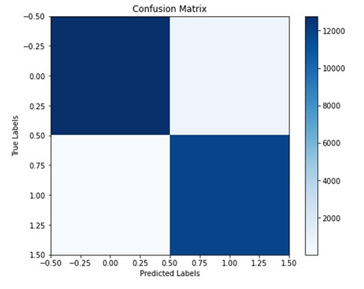
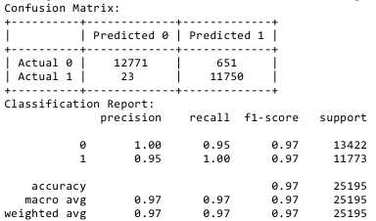
Results - Without PCA
Notes:
Confusion Matrix:
"The confusion matrix shows [specific numbers], indicating the model's performance in classifying network traffic."
Classification Report:
"Based on the classification report, the model achieves [specific metrics], demonstrating its effectiveness in intrusion detection."

Slide 8
Methodology - With PCA
Implement Principal Component Analysis (PCA) for dimensionality reduction.
Transform the dataset into a lower-dimensional space using PCA.
Train a Random Forest classifier on the reduced dataset.
Notes:
PCA Implementation:
"In this approach, we implement Principal Component Analysis (PCA) for dimensionality reduction to enhance model performance."
Model Training:
"We then train a Random Forest classifier on the reduced dataset, leveraging the benefits of PCA."

Slide 9
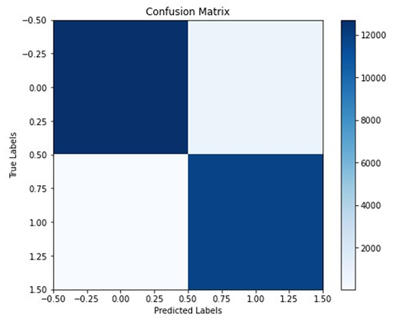
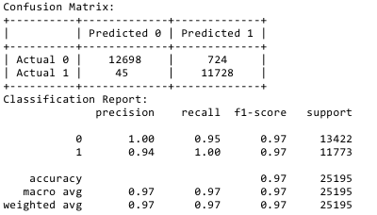
Results - With PCA
Notes:
"Similar to the previous model, the confusion matrix and classification report demonstrate the effectiveness of the Random Forest classifier with PCA."

Slide 10
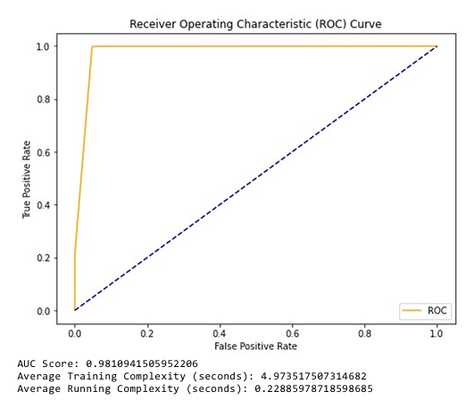
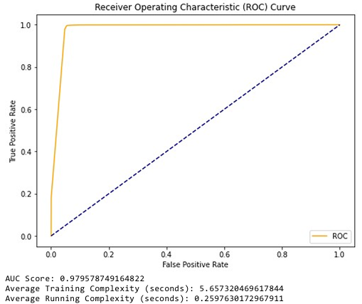
ROC, AUC & Complexity
This Random Forest model is performing exceptionally well in distinguishing between normal and intrusive network traffic. It achieves a high true positive rate while maintaining a low false positive rate, which is crucial for network security applications.
Notes:
Model Performance:
"The Random Forest model exhibits exceptional performance in distinguishing between normal and intrusive network traffic, as evident from the ROC curve and AUC metrics."
Importance of Metrics:
"These metrics are crucial for assessing the model's ability to maintain a balance between true positive and false positive rates."

Slide 11
Performance Metrics Comparison
Without PCA
With PCA
Algorithm | Accuracy | Precision | Recall
Random Forest | 97% | 97% | 97%
KNN | 97% | 97% | 97%
K-Means | 88% | 50% | 44%
Isolation Forest | 54% | 56% | 54%
Algorithm | Accuracy | Precision | Recall
Random Forest | 97% | 97% | 97%
KNN | 97% | 96% | 97%
K-Means | 93% | 50% | 47%
Isolation Forest | 54% | 56% | 54%

Slide 12
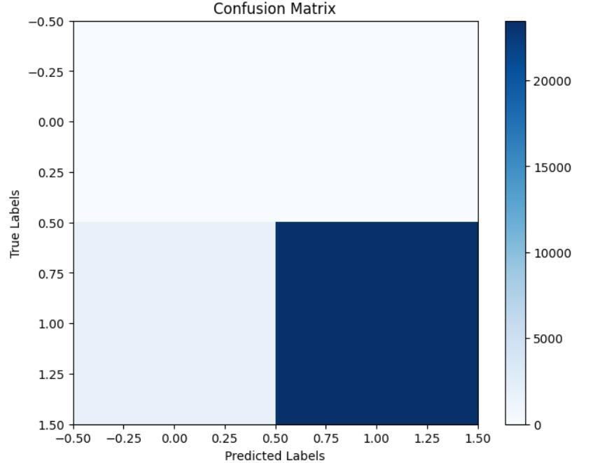
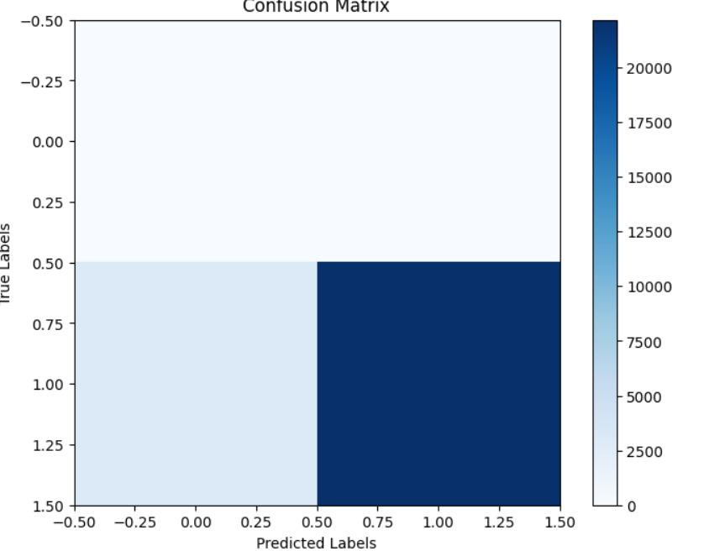
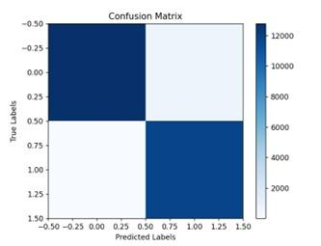

Confusion Matrix - K-Means & KNN
Algorithm | With PCA | Without PCA
K-Means
KNN

Slide 13
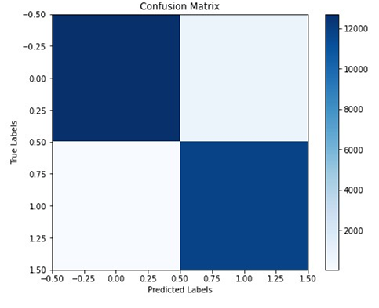
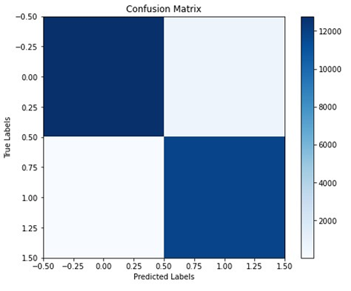
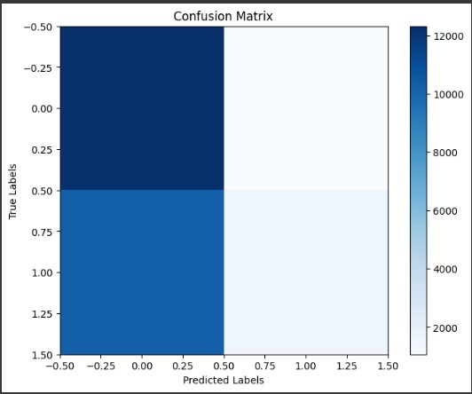
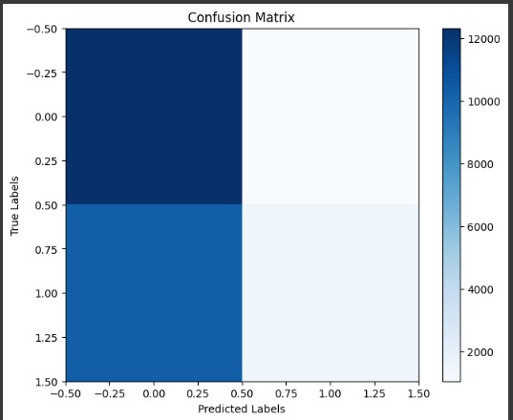
Confusion Matrix - Random & Isolation Forest
Algorithm | With PCA | Without PCA
Random Forest
Isolation Forest

Slide 14
Conclusion
Random Forest demonstrates promising results for intrusion detection in network security.
Leveraging machine learning techniques enhances our ability to detect and mitigate network threats.
Continued research and experimentation are essential for advancing intrusion detection systems.
Continuous exploration and refinement of the project will lead to more robust intrusion detection systems with higher accuracy and reliability.
Notes:
Summary of Results:
"In conclusion, Random Forest demonstrates promising results for intrusion detection, showcasing the potential of machine learning in enhancing network security."
Future Directions:
"Continued research and experimentation are crucial for advancing intrusion detection systems, paving the way for more robust and accurate models."

Slide 15
Potential Improvements
Exploration of Feature Engineering:
Explore additional features or engineered features to enhance model performance.
Experiment with different feature selection techniques to identify the most relevant features.
Optimization of Hyperparameters:
Fine-tune hyperparameters further to improve the model's performance.
Utilize advanced optimization techniques like Bayesian optimization for efficient hyperparameter tuning.
Implementation of Ensemble Methods:
Investigate ensemble methods beyond Random Forest to leverage diversity in model predictions.
Explore techniques like stacking or boosting for improved accuracy and robustness.
Enhancement of Model Interpretability:
Implement techniques for model interpretability to gain insights into the decision-making process.
Utilize techniques like SHAP (SHapley Additive exPlanations) values or feature importance analysis.
Notes:
Feature Engineering:
"Exploring additional features or engineered features can further enhance model performance."
Hyperparameter Optimization:
"Fine-tuning hyperparameters and utilizing advanced optimization techniques can improve the model's accuracy and efficiency."
Ensemble Methods:
"Investigating ensemble methods beyond Random Forest, such as stacking or boosting, can lead to improved model robustness and reliability."
Model Interpretability:
"Implementing techniques for model interpretability, such as SHAP values or feature importance analysis, can provide valuable insights into the model's decision-making process."

Slide 16
References
NSL-KDD Dataset: NSL-KDD Dataset
GitHub Repository: My Project Repository Link
Research Papers:
https://ieeexplore.ieee.org/abstract/document/9778286
https://link.springer.com/article/10.1007/s00500-021-05893-0

Slide 17

Thank You!

